Slide 1
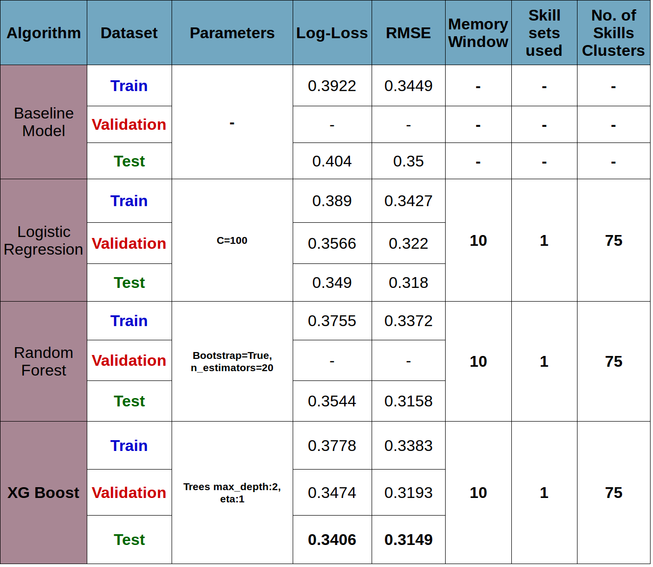
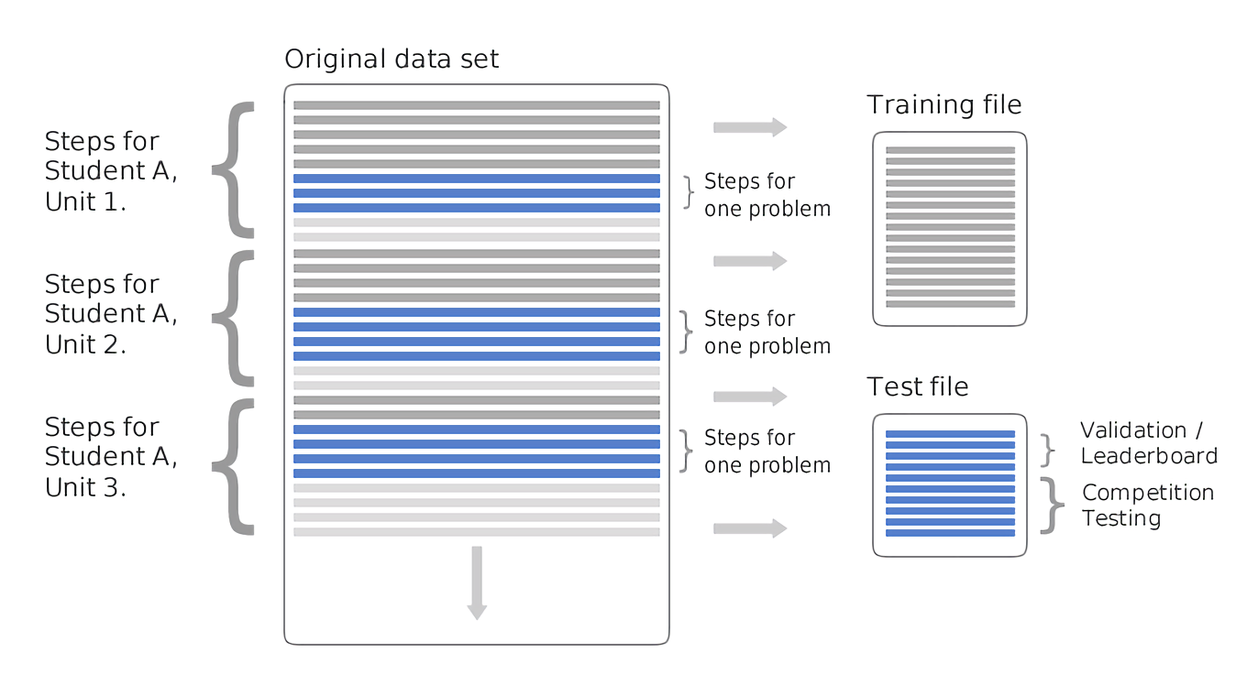
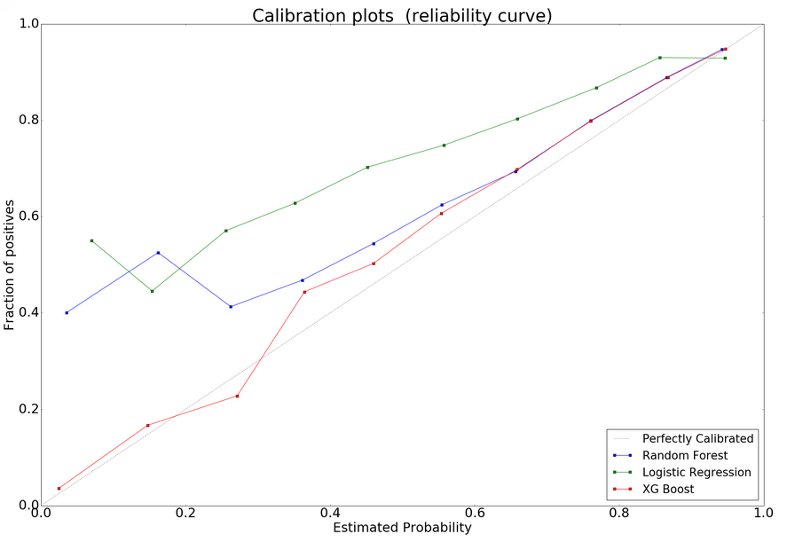
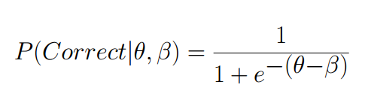
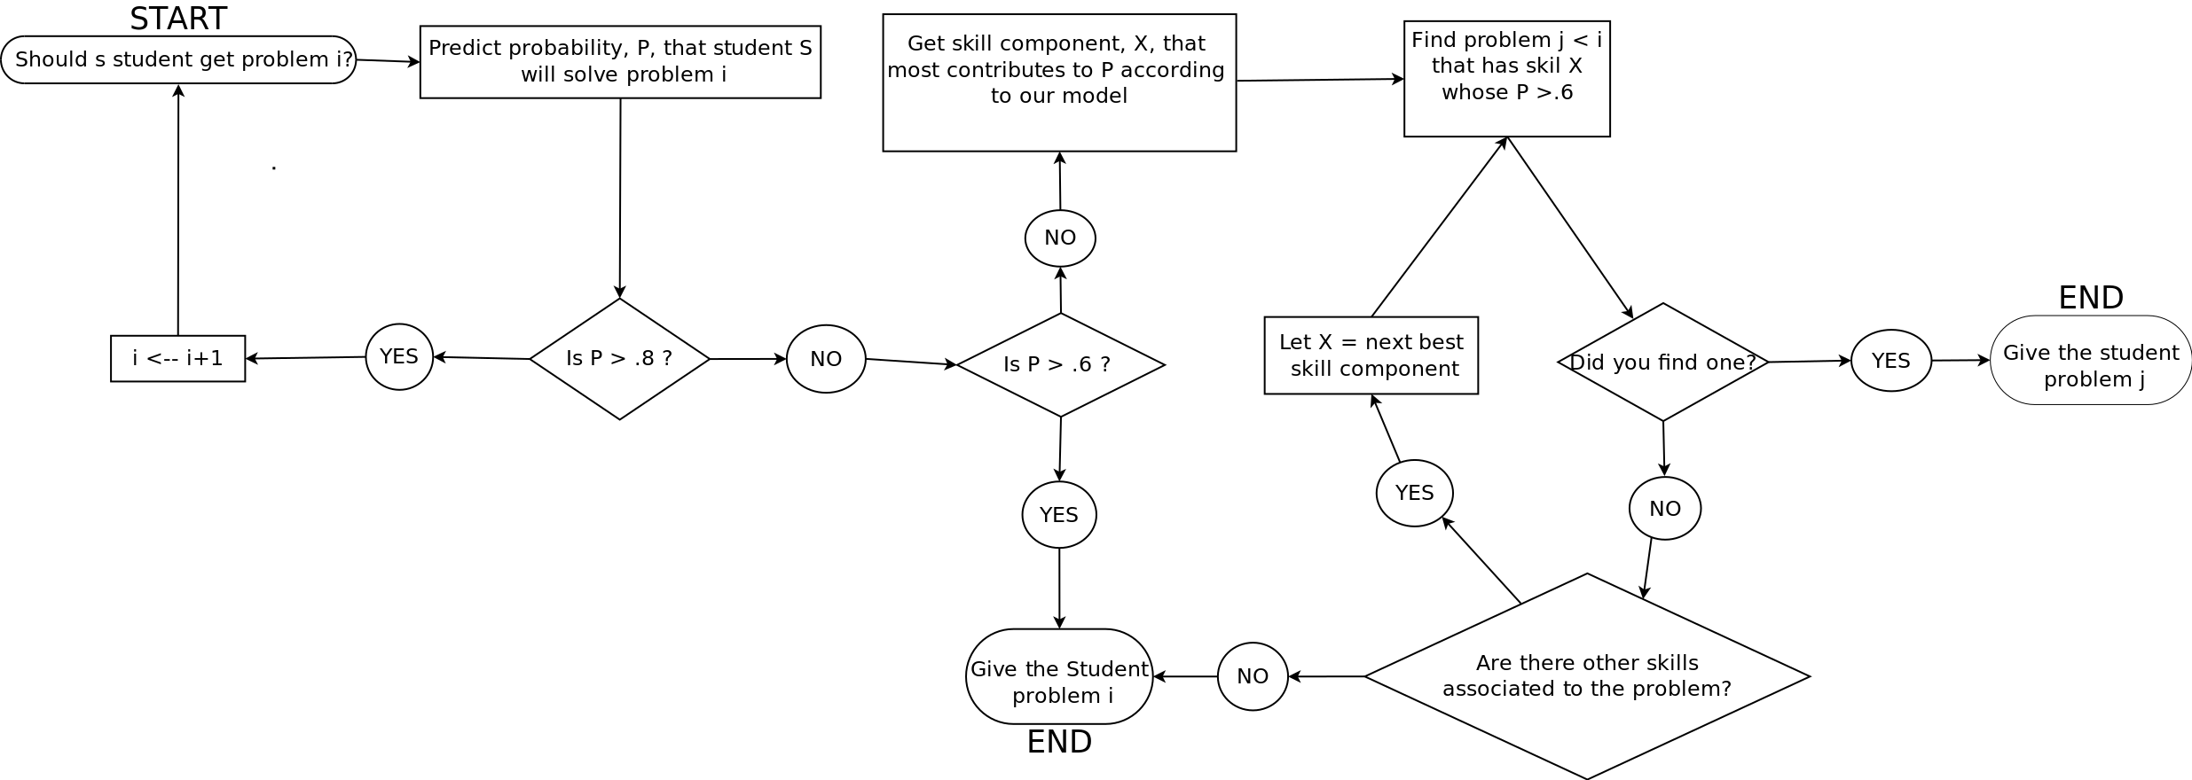
Probability calibration for online education system
Michael Higgins, Felipe Ducau, Sebastian Brarda
New York University, Center for Data Science
The Problem
Split
Feature Creation
Results
Online education has already became one of the main education formats globally. It has several advantages over traditional education: lower costs, scalability and the possibility to take classes anytime at anyplace. However, it still has some disadvantages against traditional education. One of the main drawbacks, is the lack of personalization. It is very difficult to design a system that adapts to the different student profiles.
The pace at which the different students learn varies considerably across different topics and exercise types.
If we could train a machine to understand how well a particular student has learned a particular topic, we could choose which is the right question to show next in order to optimize their rate of learning. In other words, the goal of the project is to predict as accurately as possible the probability that a student has to answer correctly any given question given his/her past performance on questions. If the probability of answering correctly a certain question is very high, the problem would be too easy and showing that problem to the student would be a waste of time. On the other hand, if the problem had a very low probability of success, the problem would be too difficult, which would generate frustration without assisting learning.
In this project, we focused on generating calibrated probability estimations and creating a personalization system based on these probabilities. In other words, the goal for this project was to create a strong probabilistic model using novel feature creation and leverage the model to create an effective recommendation system.
In order to keep the order of the dataset and treat is as a time series, we created the test set with the last problem of each unit that each student did. We did this twice, in order to create a validation set. Also, the “last problem” for each student was chosen randomly for each student, in order to maintain a balanced test set with problems answered at different points in the learning process.
After replacing the Null values from the dataset, we proceeded to feature engineering. Since the dataset is very high-dimensional in terms of instances, amount of problems (1.2M different) and different skill sets, we worked mainly with sparse representations of the data. Also, since we treated our data as a Time Series the whole time, creating features was one of the most challenging parts of the project, due to computational issues.
Some of the features we created are:
- Number of cumulative views of each of the skills
- Recent performance in each of the skills (as ratio of corrects over total)
- Recent cumulative corrects and incorrects for that problem
- Performance in the previous view of that problem
- “Hinter” index, which measures for each student the propensity to request hints.
The “Recent” performance features are based on time windows (for example, performance on the previous five times the student encountered that skill),. This windows will end up being hyper parameters of our models.
Also since there are between 500 and 600 different skills for each of the three skill types and some of the skills looked similar in their wording, we conducted a clustering of skills with K-means based on TFIDF features from the skills descriptions. The amount of clusters was an additional parameter for our model as well.
Dataset had a total of 8.918.054 rows, out of which 435.907 became the test set and 412.295 became the validation set.
Baseline Model
The simplest baseline model would be to predict based solely on the past performance of the student or the average performance of all the students on each particular problem. We used a method more sophisticated than this based on IRT (Item Response Theory) which combines these two simple models and is a standard of the industry. IRT estimates the probability of a student answering a question correctly given their past performance and the difficulty of the question. IRT takes into account that different problems “difficulty score” is dependent on the skill of the students that attempt to solve it and the “skill score” of a given student is dependent on which problems they attempt to solve.
The original version of IRT is trained by maximizing likelihood of data after assuming a prior distribution of the parameters “student” and “problem”. It happens that IRT reduces to logistic regression with parameter Lambda where Lambda takes the place of the prior distribution.
The Data
The dataset come from Intelligent Tutoring Systems (ITS) system used by thousands of algebra and pre-algebra high-school students. Originally, the dataset was used for the KDD cup 2010, a competition whose objective was to achieve the minimum Root Mean Squared Error (RMSE) in predicting probability of being successful in the first attempt of the next question.
The exercises of the system are divided into a four stage hierarchy; unit, section, problem and step. The collection of steps comprises a problem. For each step that a student attempts there is a row in our data frame that summarizes all of the students previous attempts at solving the step. This includes the quantity of hints requested, the number of incorrect attempts at the problem, the unit and problem to which the step belongs, the knowledge components of the step along with the number of times a student has previously encountered a step that involved each knowledge component.
A knowledge component (KC) is a skill, fact or principle that is used to solve the step. There are three different types of KC with 500-600 different categories in our dataset.
An important thing to mention is that the original dataset was already split into training and test sets in a time series manner. This means that the order is important for our problem, and we cannot split test and training sets randomly. The following chart shows the way that the data was splitter for our problem.
Collaborative Filtering
In some sense the education problem can be though as the “Netflix problem” in the sense that different groups of students might be similar in terms of which kind of problems or skills they are good or bad at. The same can be though problem problems. We trained a collaborative filtering model with the information of the problems, students and the performance of each of them (without any additional feature). The only hyper parameter of this model was the number of latent variables. The results were surprising: using 8 latent variables, we achieved a Log-Loss of 0.4182 and a RMSE of 0.3312 . This performance is relatively close to the performance achieved by the other models with the complete set of features and also close to the performance achieved by the participants of the competition. Because of that, we added the “student factor” and “problem factor” (and their inner product) from the decomposition matrix as features to feed our other models, which helped to improve performance considerably.
Where Theta represents how difficult a problem is, and Beta how good the student is. Both values are estimated from the data
Performance Evaluation
Recommendation System
Since the goal of the project is to get well calibrated probabilities, we had to restrict our loss functions to the set of Proper Scoring Rules, or any Loss function that allowed transformation into a Proper Scoring Rule. Because of that we decided to use Log-Loss and RMSE as performance evaluations. Both loss functions will be minimized when the probability estimation is optimal. RMSE was chosen as the secondary performance metric because it was the original evaluation metric for the KDD cup competition and we used it as a sanity check. Finally, each model will be compared not only on these metrics but also taking into account their calibration plots.

